Slide 1

The Distribution of Birthdays and the Birthday Paradox
DATA 602 - Statistical Data Analysis
Ali Afkhami (30271805)
Daniela Mañozca Cruz (30262558)
Evan Losier (30022571)
Luisa Alejandra Sierra Guerra (30261956)
Ruby Nouri-Kermani (30261323)

Slide 2

Table of Contents
Introduction
Project Goals
Part 1- Exact Probability
Part 2 - Probability using Monte-Carlo Simulation
Part 3 - Birth mates with Monte-Carlo Simulation
Part 4 - Uniform Birthday Distribution
Part 5 - Smoothed Weekly Birth Distribution
Part 6 - Non-Uniform Distribution of Birthdays
Conclusions

Slide 3


Introduction
The Birthday Problem (or Birthday Paradox) is a statistics experiment that challenges our intuition about probability by asking how many people we need in a room before at least two of them share the same birthday. Since there are 365 days in a year, we expect the chance for people to share a birthday to be low, but surprisingly, we only need 23 people to observe a 50% chance of a shared birthday. With 60 people, the chance is nearly 100%.

Slide 4

What is the goal of this project?
Analyze the paradox using combinatorial probability and Monte Carlo simulations.
Compare theoretical calculations with simulated results.
Visualize how the probability of shared birthdays increases with group size.
Perform Chi-Square test
Using real dataset to perform uniform distribution
Compare real data to theoretical calculation.

Slide 5

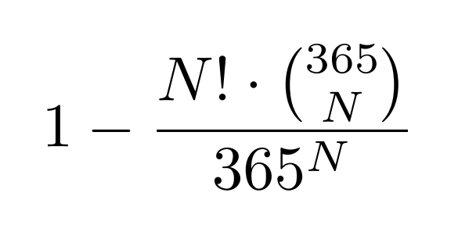
Part 1. Exact Probability Using Combinatorial Formula
Probability Using Combinatorial Formula

Slide 6
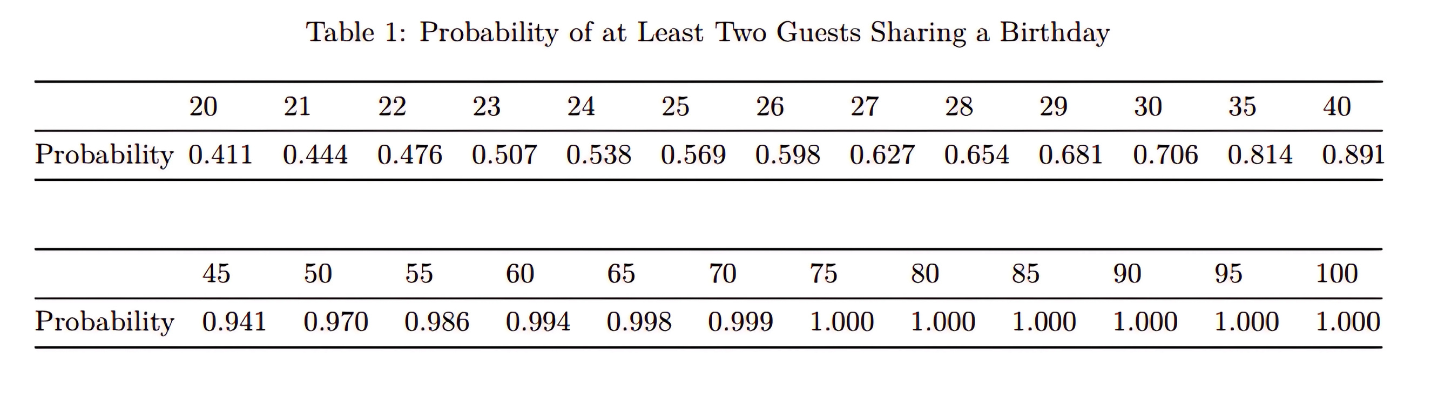



Part 1. Exact Probability Using Combinatorial Formula
45
0.941

Slide 7
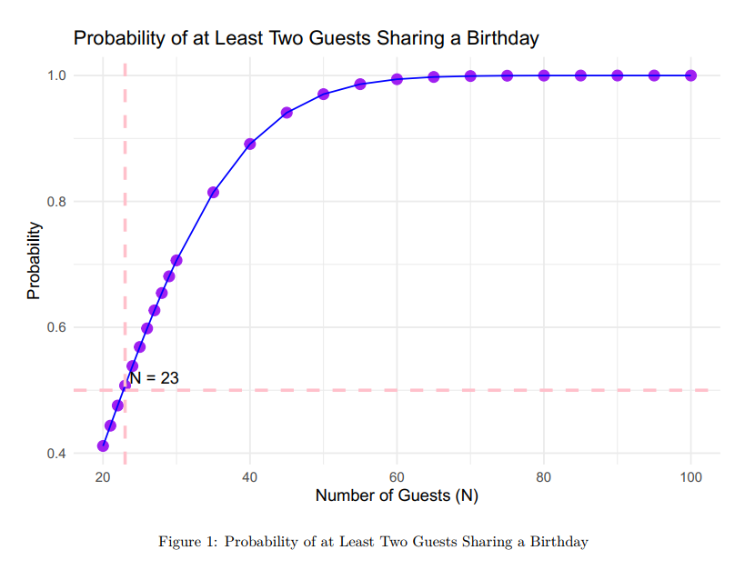

Slide 8
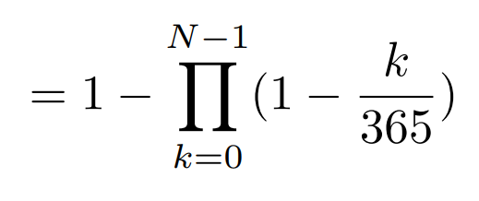
Part 2. Probability Using Monte Carlo Simulation
The probability that at least two people share a birthday:
P (at least 2 people share birthdays) = 1 - P (no shared birthdays)

Slide 9
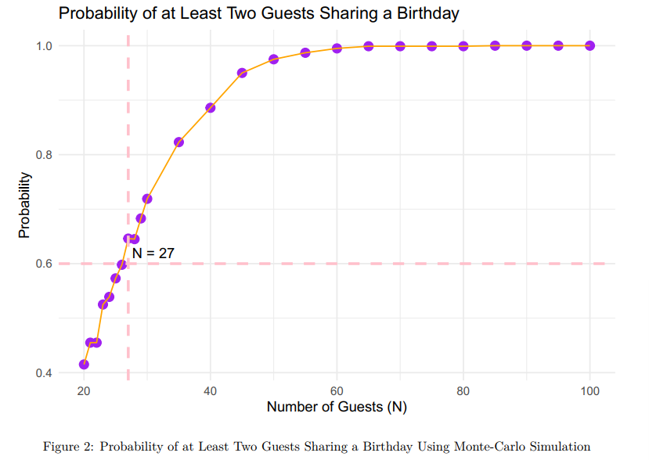

Slide 10
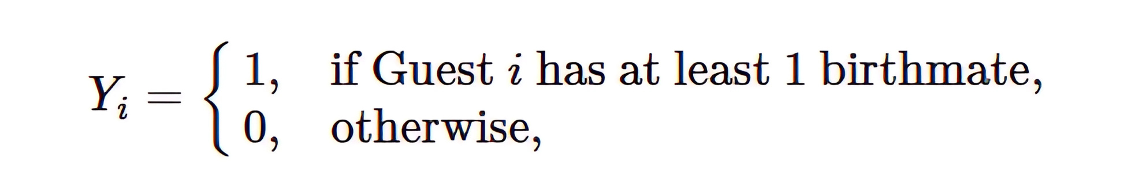

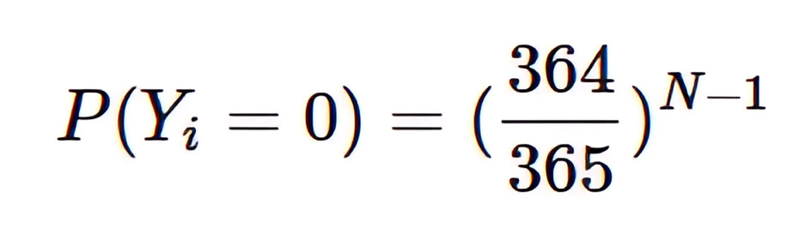
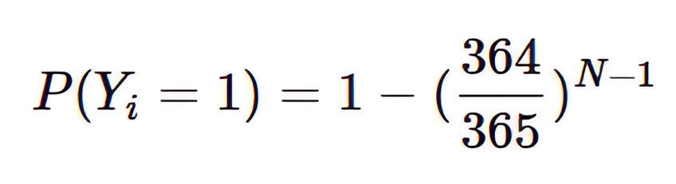
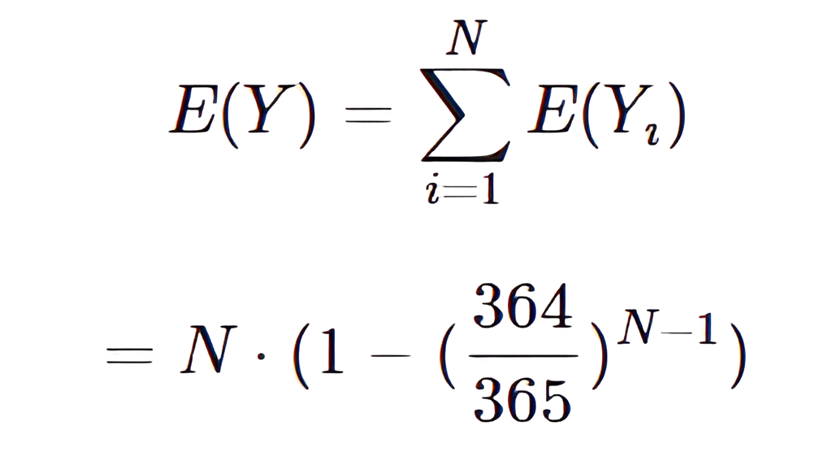
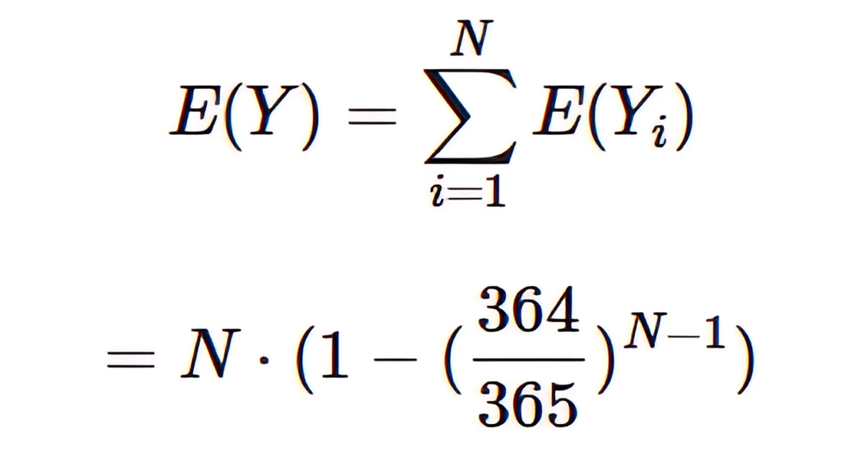
Part 3. Birthmates

Slide 11
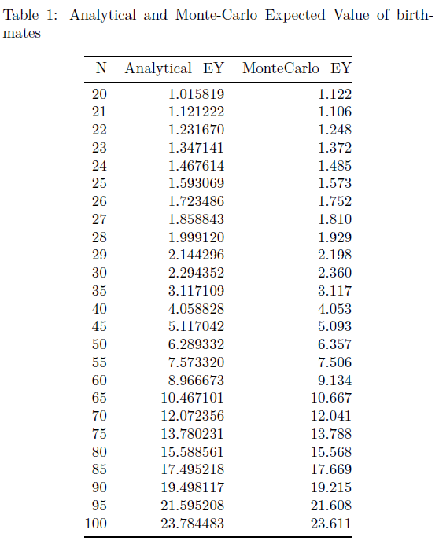
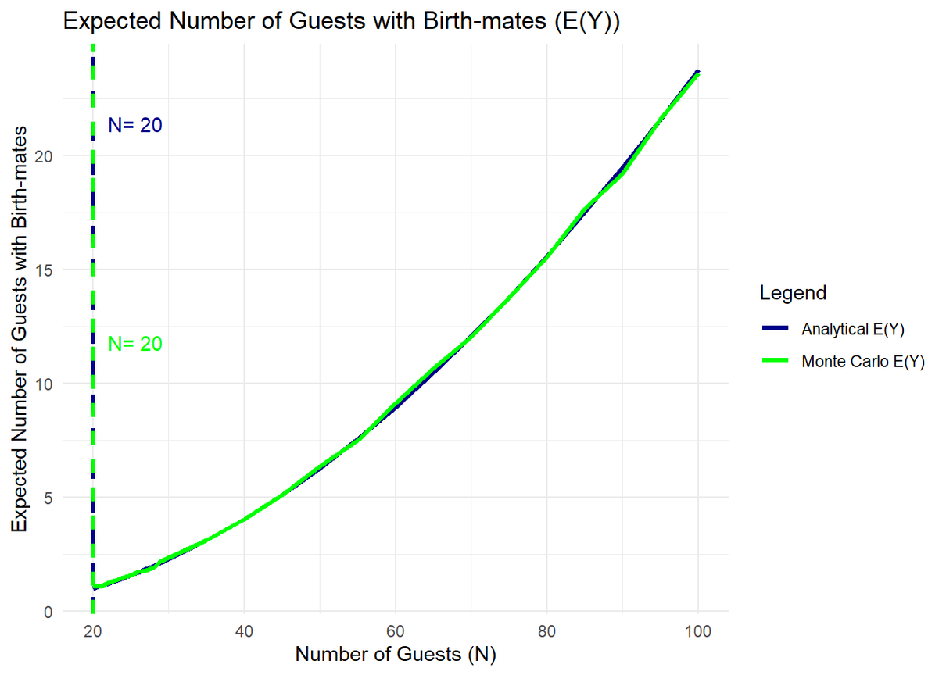

Slide 12
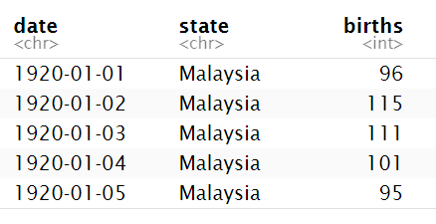
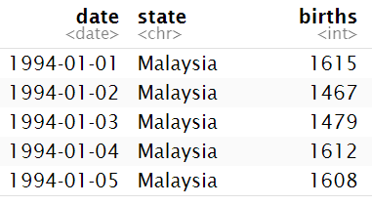
Part 4. Uniform Birthday Distribution
Since all days of the year might have the same probability of birth: Is it true that birthdays follow a uniform distribution?
We will verify this using a data set from Malaysia Open Portal, which contains records from 1920 to 2022.
To ensure our analysis reflects the most up to date information, the data is filtered to only include dates from 1994 onward.
Original Data Sample
Filtered Data Sample

Slide 13
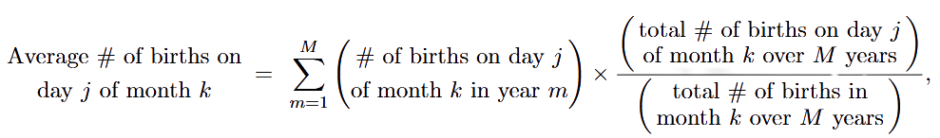
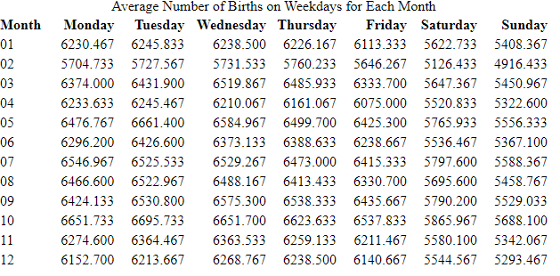
To validate the assumption of a uniform distribution, the data is summarized using two statistical terms.
The first one is as follows:
for j=1 (Monday),...,7 (Sunday)
for k=1 (January),...,12 (December)
where m E {1,...,M} indicates the years analized.

Slide 14
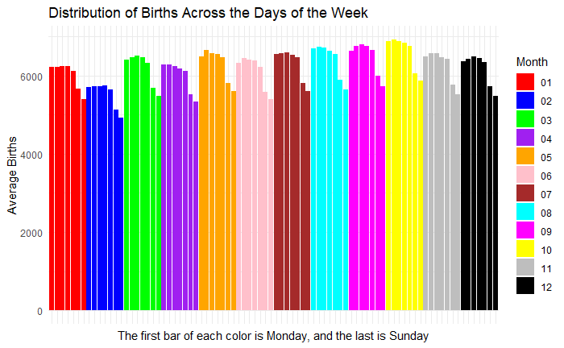
Part 4. Uniform Birthday Distribution
Although we expected a uniform distribution over the seven days of the week for each month, the dataset shows a different pattern. From Monday to Friday, the average remains stable and almost uniform, but it clearly decreases on Saturday and Sunday across all months.

Slide 15
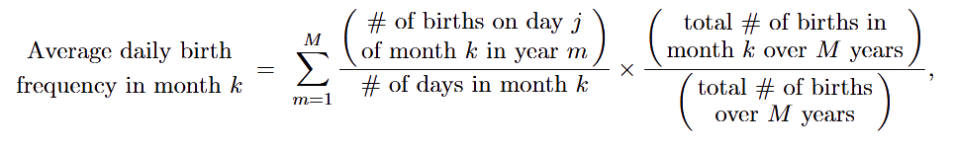
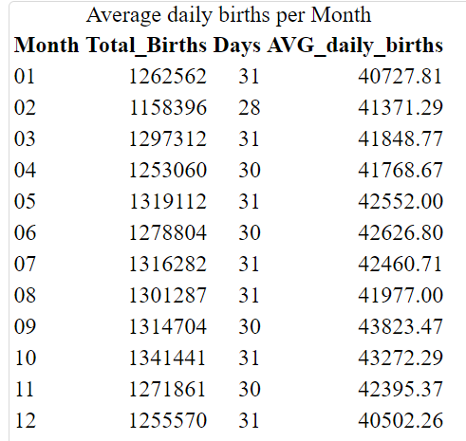
Part 4. Uniform Birthday Distribution
To validate the assumption of a uniform distribution, the data is summarized using two statistical terms.
The second one is as follows:
for j=1 (Monday),...,7 (Sunday)
for k=1 (January),...,12 (December)
where m E {1,...,M} indicates the years analized.

Slide 16
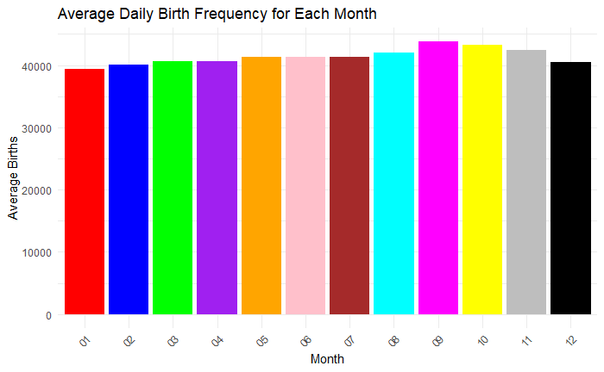
Part 4. Uniform Birthday Distribution
In the bar plot, we can see that September and October have the highest average daily birth rates, while January and December have the lowest averages. Once again, we should consider that the assumption that birthdays follow a uniform distribution might not be true.

Slide 17
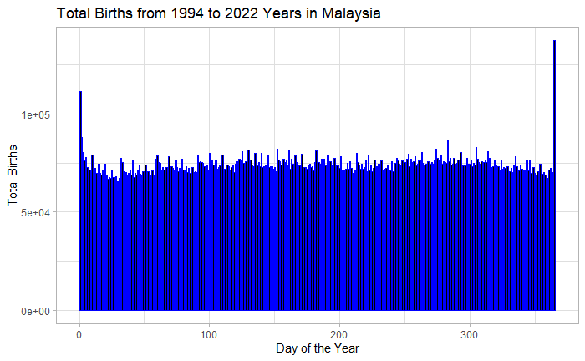
Part 4. Uniform Birthday Distribution
Chi-squared test results:
X-squared = 9891.9
df = 3 64
p-value = 2.2e-16
The Chi square test shows high discrepancy between the real data and the expected data. In this test, the null hypothesis assumed that births are equally likely on any day of the year. However, the test strongly rejects this assumption, since the p-value is extremely low (2.2e-16) This is less than the significance level 0.05, meaning births are not uniformly distributed across the year. Some days have more births than expected, while others have fewer.

Slide 18

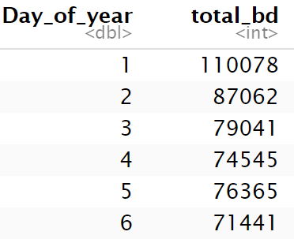
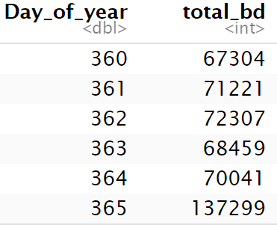
Part 5. Smoothed Weekly Birth Distribution
Since we observed a difference in births by day of the week, we can analyze the problem from a different angle by “smoothing” the data and removing variation. The proportion of daily births was consistently low on weekends, so we can smooth the data by observing full weeks of births instead.
Data Preparation

Slide 19
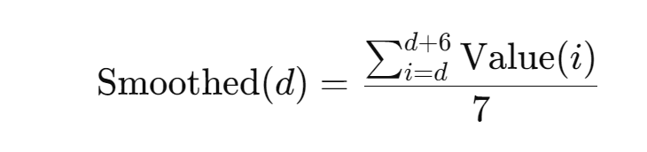


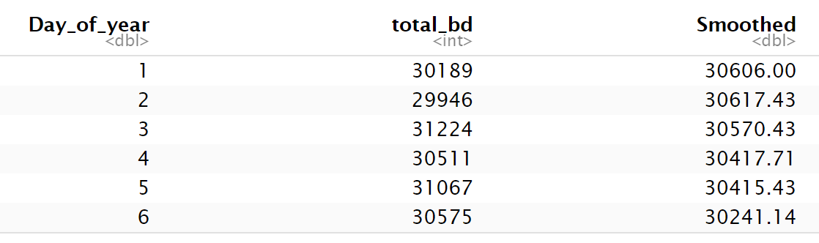

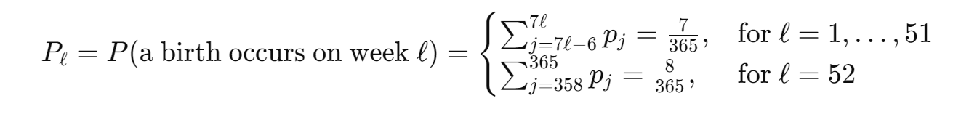
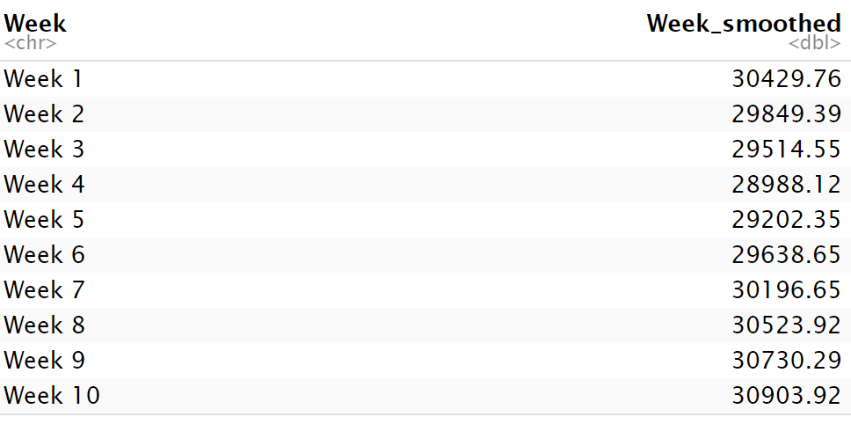
2. Smoothing the Data
360 + 361 + 362 + 363 + 364 + 365 + 1
7
3. Weekly Aggregation
May
(31)

Slide 20
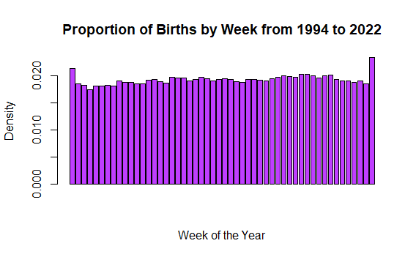

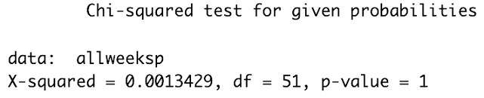


H₀: The observed data follows the expected uniform distribution.
H₁: The observed data does not follow the expected uniform distribution.
p-value > 0.05 we fail to reject H0

Slide 21

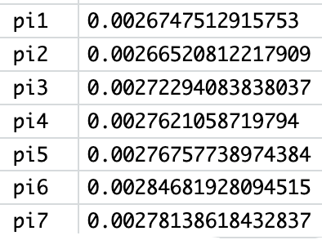
Part 6. Non-Uniform Distribution of Birthdays
To analyze a non-uniform distribution, the births from Malaysia were split into 7 groups (pi1 - pi7) and the probability that a birth occurred within any one of those groups was calculated.
November
(30)
October
(31)
December - February (91)
March (31)
June - September (122)
April (30)
May
(31)

Slide 22
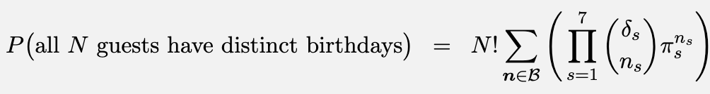
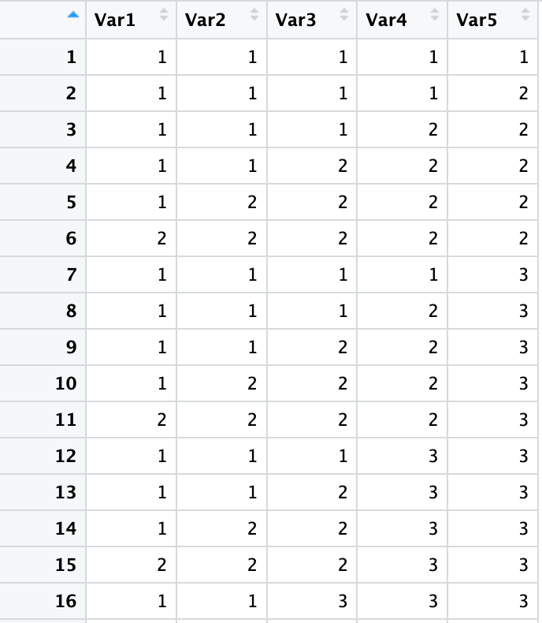
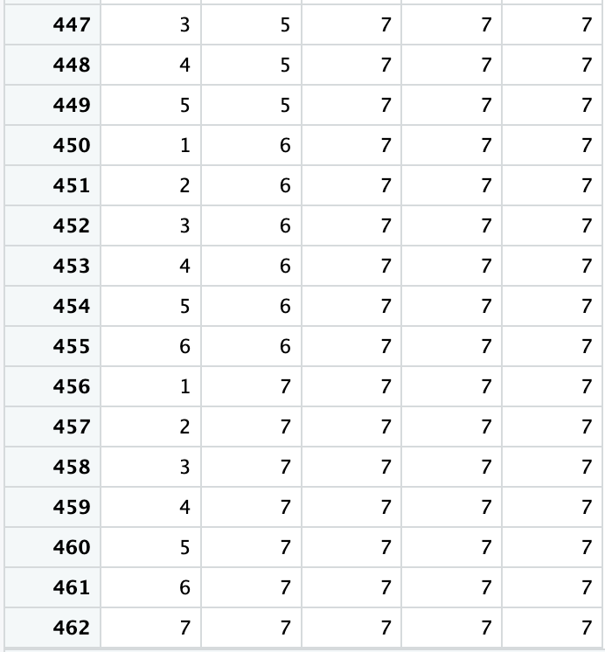
The Math Behind Non-Uniform Distributions

Slide 23
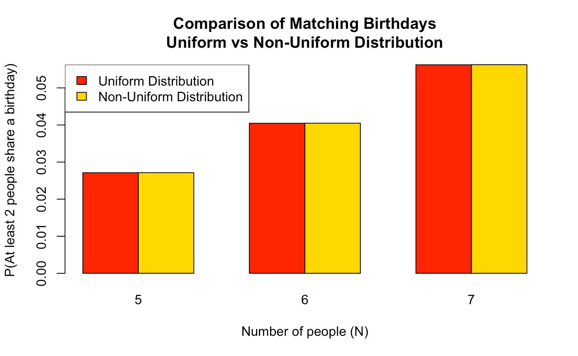
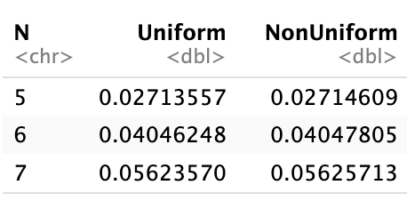

Slide 24
Conclusion
From our analysis of the birthday paradox, we observed the following:
The number of people required to have a 50% of at least two sharing a birthday is 23, both by statistical calculation and Monte Carlo simulation.
The expected value for number of birthdays that result in birthmates is 20, lower than the number of people required for a 50% chance because of cases where more than 2 people share a birthday.
When looking at real world data, we do not observe a uniform distribution of birthdays. Weekday births are consistently more common than weekend births.
Smoothing the real world data by week provides a uniform distribution.
When calculating probabilities of shared birthday for a non-uniform distribution, the likelihood of shared birthdays increases, but only slightly.

Slide 25


THANK TOU

Slide 26

QUESTIONS?

